Slide 1
Deep Neural Networks
(AIML ZG511)

Slide 2
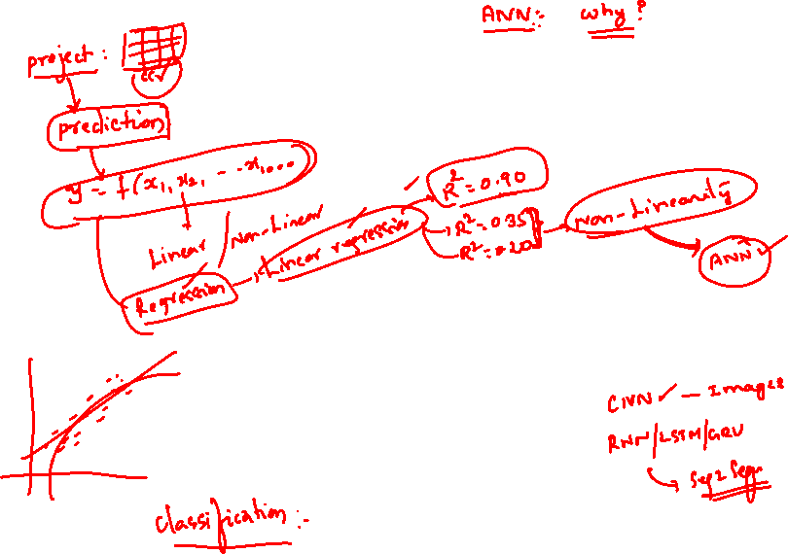
MODULE # 9 :
Attention Mechanism
Session 12
(26th July 2026)

Slide 3
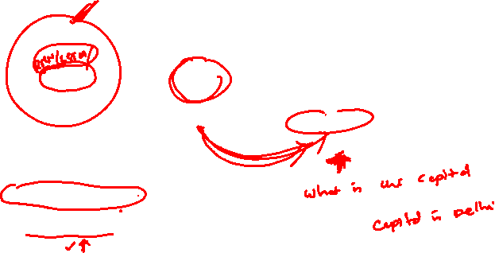

Slide 4


Slide 5


Slide 7
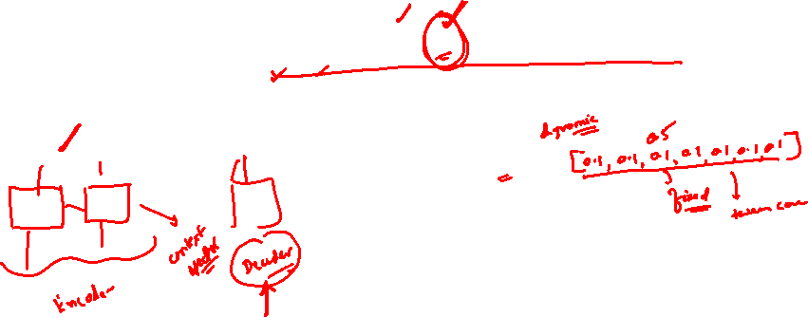


Slide 8
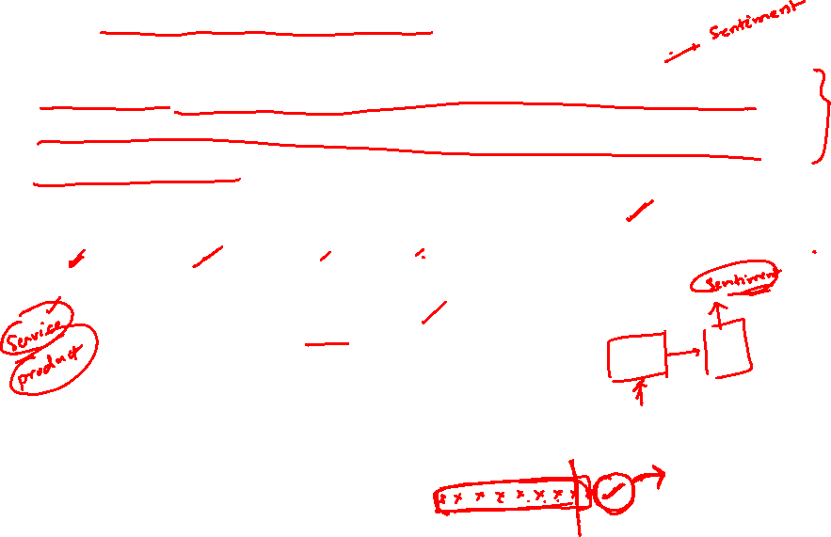

Slide 10
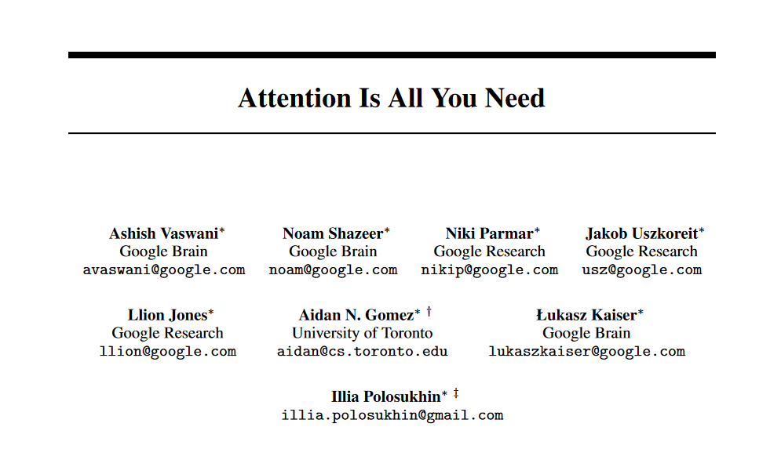
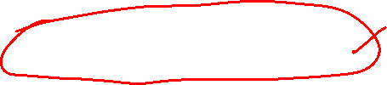
Transformer

Slide 11
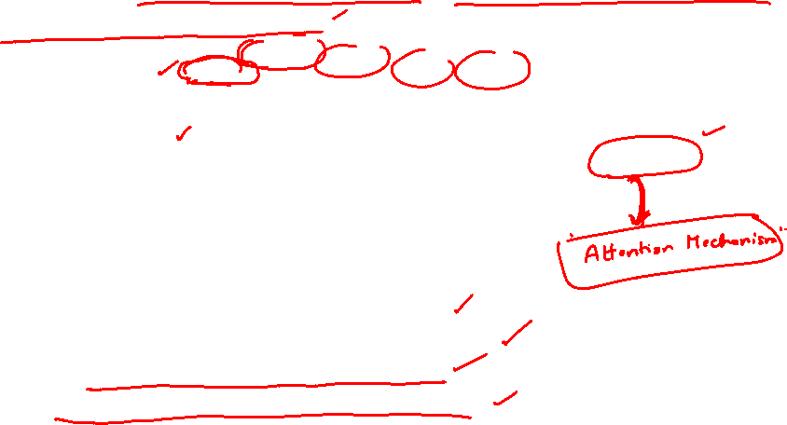

Slide 12
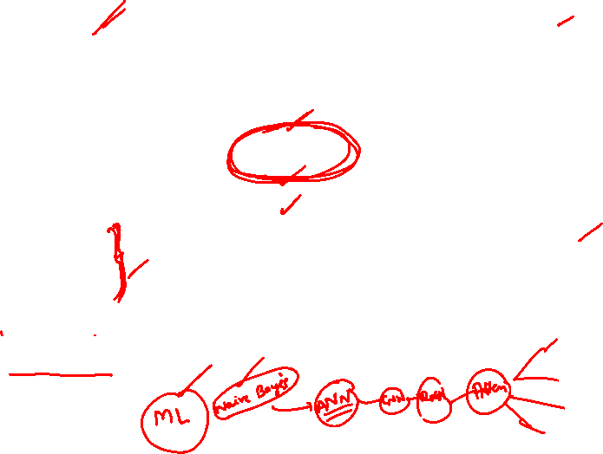

Slide 13


Slide 14
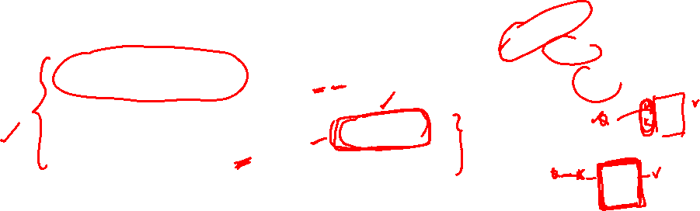
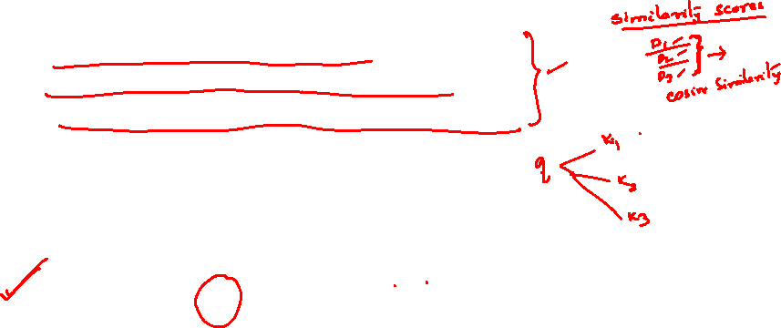

Slide 15


Slide 16


Slide 17


Slide 18
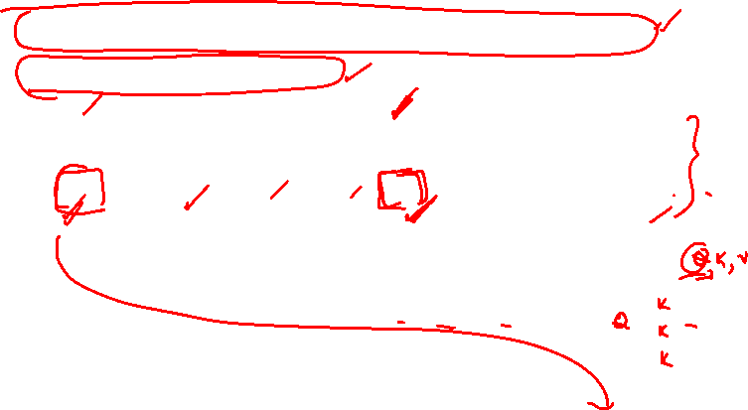

Slide 21


Slide 22
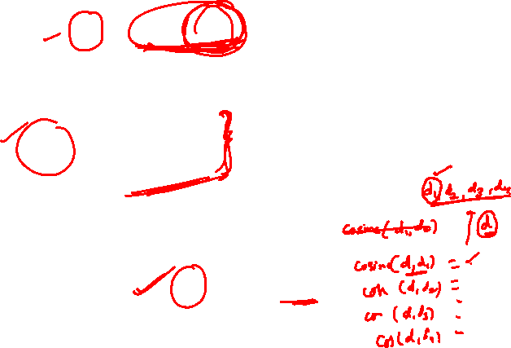

Slide 26


Slide 27


Slide 29
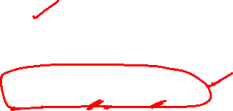

Slide 30


Slide 38
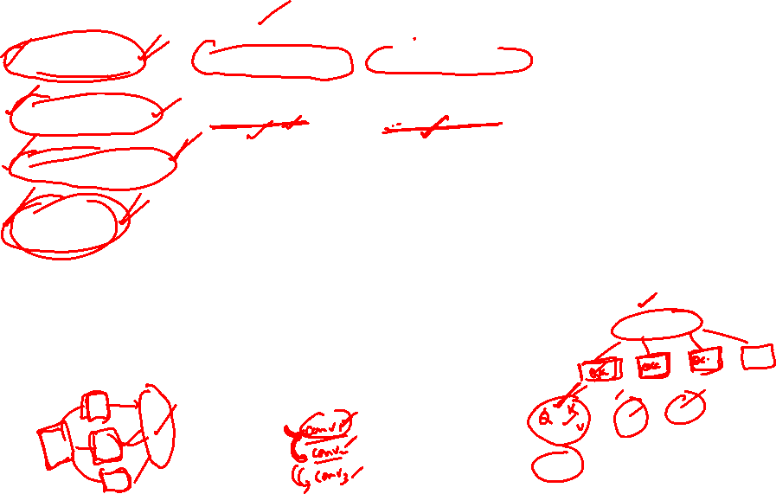

Slide 39


Slide 42


Slide 44


Slide 45


Slide 46


Slide 47


Slide 48
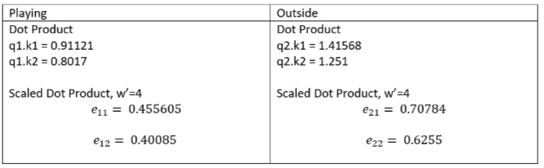
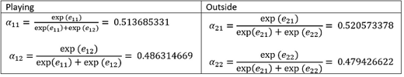

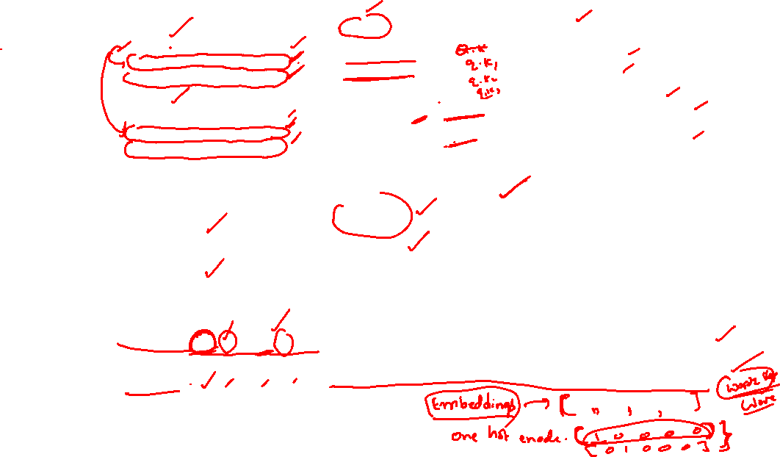


Solved example (without masking the future)
Playing
q1 = [0.212 0.04 0.63 0.36]
k1 = [0.31 0.84 0.963 0.57]
v1 = [0.36 0.83 0.1 0.38]
Outside
q2 = [0.1 0.14 0.86 0.77]
k2 = [0.45 0.94 0.73 0.58]
v2 = [0.31 0.36 0.19 0.72]
$$y_{1}$$
$$y_{2}$$

Slide 51
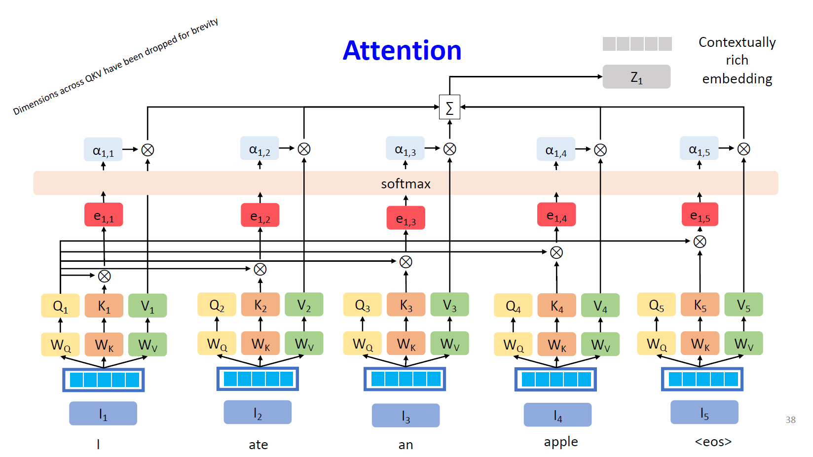

Slide 54
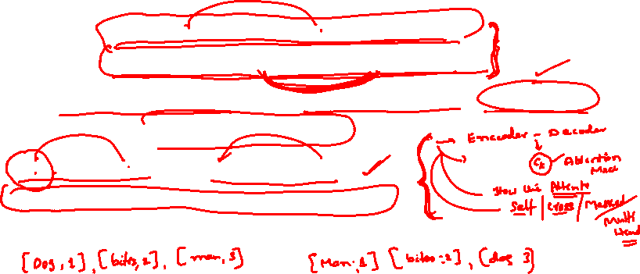

Slide 55

Positional Embeddings
positional encoding indicates the absolute and relative position of the tokens in the sequence.
For example, in “The cat watches the dog run fast.”, if the position of “cat” and “dog” were interchanged, it would alter subject and object and thus the meaning of the sentence.

Slide 56


Slide 57
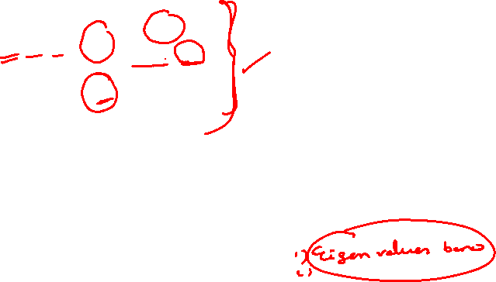

Slide 59
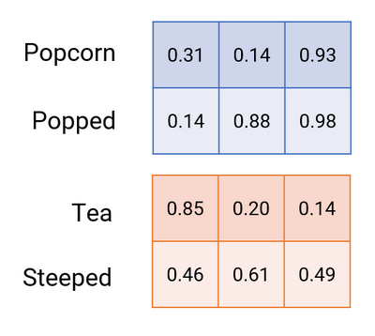
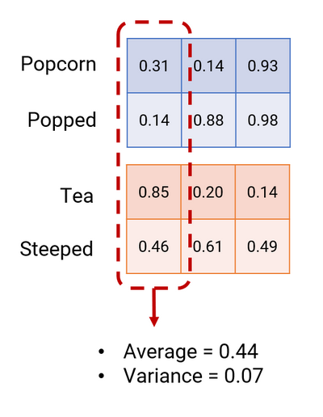
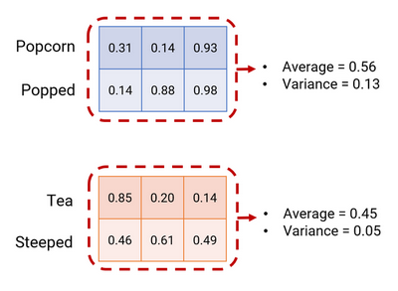
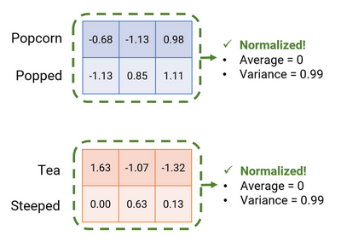
Normalization(Batch and Layer)

Slide 62
TRANSFORMER

Slide 68
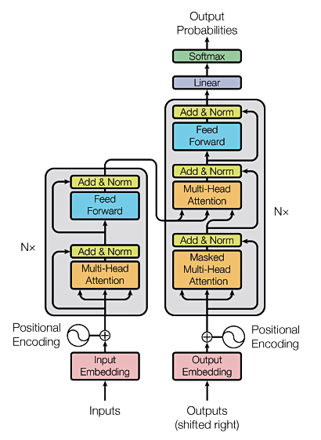
TRANSFORMERS

Slide 69
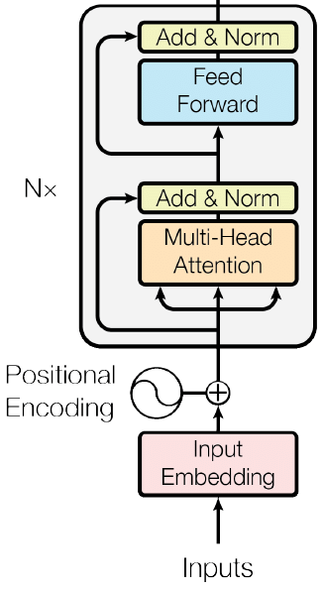
The Transformer - Encoder
Self attention

Slide 70
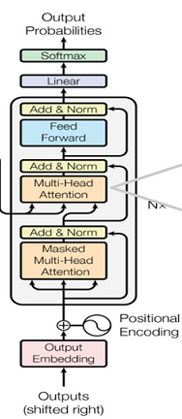
The Transformer - Decoder
Cross
attention
Masked Self attention

Slide 71



Slide 72
BERT
BERT, which stands for Bidirectional Encoder Representations from Transformers.
In 2018, Google introduced and open-sourced BERT. In its research stages, the framework achieved groundbreaking results in 11 natural language understanding tasks, including sentiment analysis, semantic role labeling, sentence classification ,words with multiple meanings etc.
BERT is a “deeply bidirectional” model. Bidirectional means that BERT learns information from both the left and the right side of a token’s context during the training phase

Slide 73
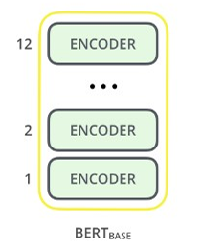
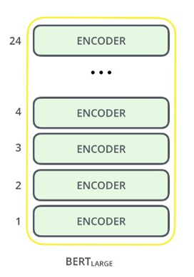

BERT
The BERT architecture builds on top of Transformer. We currently have two variants available:–
BERT Base: 12 layers (transformer blocks), 12 attention heads, and 110 million parameters–
BERT Large: 24 layers (transformer blocks), 16 attention heads and, 340 million parameter

Slide 74

Pre-trained models
patentBERT - a BERT model fine-tuned to perform patent classification.
docBERT - a BERT model fine-tuned for document classification.
bioBERT - a pre-trained biomedical language representation model for biomedical text mining.
VideoBERT - a joint visual-linguistic model for process unsupervised learning of an abundance of unlabeled data on Youtube.
SciBERT - a pretrained BERT model for scientific text
G-BERT - a BERT model pretrained using medical codes with hierarchical representations using graph neural networks (GNN) and then fine-tuned for making medical recommendations.

Slide 75
Pre-trained models
TinyBERT by Huawei - a smaller, "student" BERT that learns from the original "teacher" BERT, performing transformer distillation to improve efficiency. TinyBERT produced promising results in comparison to BERT-base while being 7.5 times smaller and 9.4 times faster at inference.
DistilBERT by HuggingFace - a supposedly smaller, faster, cheaper version of BERT that is trained from BERT, and then certain architectural aspects are removed for the sake of efficiency
AstraZeneca and NVIDIA developed MegaMolBART, a transformer tailored for drug discovery

Slide 76
Pre-training for three types of architectures
Encoder-only models
Gets bidirectional context – can condition on future!
How do we train them to build strong representations?
Also known as auto-encoding models
For tasks that require understanding of the input, e.g sentence classification and named entity recognition
Representatives of this family of models include:
  ALBERT, BERT, DistilBERT, , ELECTRA, RoBERTa

Slide 77
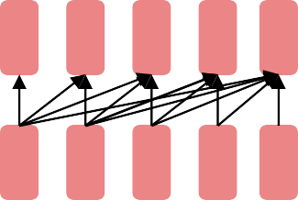
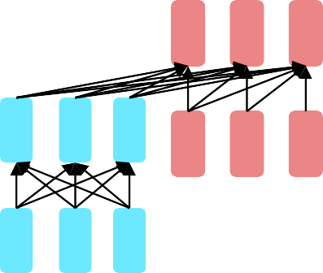
Pre-training for three types of architectures
Decoder-only models
Language models
Nice to generate from; can’t condition on future words
These models are also known as auto-regressive models.
Representatives of this family of models include:
  CTRL, GPT series, Transformer XL
Encoder-decoder models or sequence-to-sequence models
For generative tasks that require an input, such as translation or summarization . BART/T5-like

Slide 83

